Slide 1
The Relational Algebra-I

Slide 2
General Guideline
© (2021) ABES Engineering College.
This document contains valuable confidential and proprietary information of ABESEC. Such confidential and proprietary information includes, amongst others, proprietary intellectual property which can be legally protected and commercialized. Such information is furnished herein for training purposes only. Except with the express prior written permission of ABESEC, this document and the information contained herein may not be published, disclosed, or used for any other purpose.

Slide 3
Topics to be covered
Relational Algebra overview
Relational Algebra operations
Select (σ )
Project (Π)
Rename (ρ)
Set Union (∪)
Set Intersection (∩)
Set Difference or Minus (-)

Slide 4
Relational Algebra Overview
Relational algebra is the basic set of operations for the relational model.
These operations enable a user to specify basic retrieval requests (or queries)
It consists of a set of operations that take one or two relations as input and produce a new relation as its output (result).
A sequence of relational algebra operations forms a relational algebra expression
The result of a relational algebra expression is also a relation that represents the result of a database query (or retrieval request)
14

Slide 5
Relational Algebra Overview
The Relational Algebra is a procedural query language.
Query Language
A Language which is used to store and retrieve data from database is known as query language. For example – SQL
There are two types of query language:
1.Procedural Query language 2.Non-procedural query language
Query Language
Procedural Query Language
Non-Procedural Query Language
14

Slide 6
Relational Algebra Overview
Procedural Query language:
In procedural query language, user instructs the system to perform a series of operations to produce the desired results. Here users tells what data to be retrieved from database and how to retrieve it.
Non-procedural query language:
In Non-procedural query language, user instructs the system to produce the desired result without telling the step by step process. Here users tells what data to be retrieved from database but doesn’t tell how to retrieve it.
Query Language
Procedural Query Language
Non-Procedural Query Language
Relational Algebra
Relational Calculus
SQL
Note :
Relational algebra and calculus are the theoretical concepts used on relational model.
SQL is a practical implementation of relational algebra and calculus. It is a non-procedural language.
14

Slide 7

Relational Algebra (RA) Operations
Fundamental Operations
Select (σ )
Project (Π)
Rename (ρ)
Set Union (∪)
Set Difference or Minus (-)
Cartesian Product (X)
Additional Operations
Set Intersection (∩)
Join ( )
Divide (÷)
Assignment (←)
Extended RA Operations
Generalized Project (∏)
Aggregate Functions (G)
Fundamental Operations
The select, project, and rename operations are called unary operations, because they operate on one relation. The other three operations operate on pairs of relations and are, therefore, called binary operations.
14

Slide 8
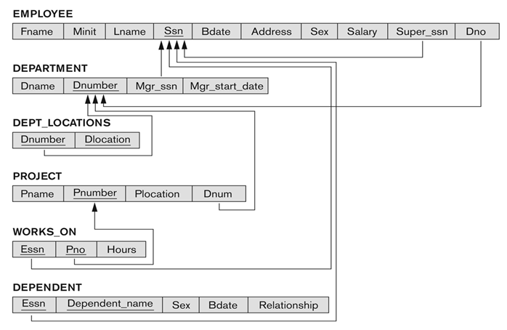
Database State for COMPANY
All examples discussed further will refer to the COMPANY database shown here.

Slide 9
Unary Relational Operations: SELECT
The SELECT operation (denoted by σ (sigma)) is used to select a subset of the tuples from a relation based on a selection condition.
The selection condition acts as a filter
σ_{P} (r) : Keeps only those tuples from relation r, which satisfy predicate P.
Tuples satisfying the condition are selected whereas the other tuples are discarded (filtered out)
The predicate P will involve:-
Attributes from Schema R of r
Literals
Comparison Operators: <, > , < , >, =, ≠
Logical Operator: ∧ (AND) , ∨ (OR) , ¬ (NOT)

Slide 10
Unary Relational Operations: SELECT
Examples:
1. Select the EMPLOYEE tuples whose department number is 4:
σ _{Dno=4} (EMPLOYEE)
2. Select the employee tuples whose salary is greater than $30,000:
σ _{SALARY > 30,000} (EMPLOYEE)

Slide 11
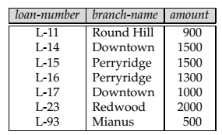

Unary Relational Operations: SELECT
Example:
Find those tuples pertaining to loans of more than $1200 made by the Perryridge branch,
σ_{branch-name} _{= “Perryridge” ∧ amount>1200} (loan)
loan

Slide 12
Unary Relational Operations: SELECT
SELECT Operation Properties :
The SELECT operation σ _{<selection condition>}(R) produces a relation S that has the same schema (same attributes) as R
SELECT σ is commutative:
σ _{<condition1>}(σ _{< condition2>} (R)) = σ _{<condition2>} (σ _{< condition1>} (R))
Because of commutativity property, a cascade (sequence) of SELECT operations may be applied in any order:
σ _{<cond1>}(σ _{<cond2>} (σ _{<cond3>} (R)) = σ _{<cond2>} (σ _{<cond3>} (σ _{<cond1>} ( R)))
A cascade of SELECT operations may be replaced by a single selection with a conjunction of all the conditions:
σ _{<cond1>}(σ _{< cond2>} (σ _{<cond3>}(R)) = σ <cond1> AND < cond2> AND < cond3>(R)))
The number of tuples in the result of a SELECT is less than (or equal to) the number of tuples in the input relation R

Slide 13
Unary Relational Operations: PROJECT
PROJECT Operation is denoted by Π (pi) . This operation keeps certain columns (attributes) from a relation and discards the other columns.
PROJECT creates a vertical partitioning
The general form of the project operation is: Π _{<attribute list>}(R)
Π (pi) is the symbol used to represent the project operation
<attribute list> is the desired list of attributes from relation R.
The project operation removes any duplicate tuples. This is because the result of the project operation must be a set of tuples. Mathematical sets do not allow duplicate elements.
Example: To list each employee’s first and last name and salary, the following is used:
Π_{Fname, Lname,Salary}(EMPLOYEE)

Slide 14
Unary Relational Operations: PROJECT
PROJECT Operation Properties
The number of tuples in the result of projection Π _{<list>}(R) is always less or equal to the number of tuples in R
If the list of attributes includes a key of R, then the number of tuples in the result of PROJECT is equal to the number of tuples in R
PROJECT is not commutative
Π _{<list1>} (Π _{<list2>} (R) ) = Π _{<list1>} (R) as long as <list2> contains the attributes in <list1>

Slide 15
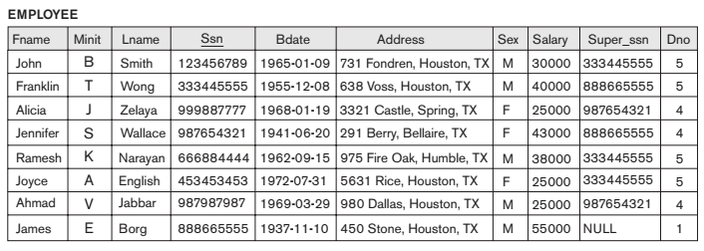

Unary Relational Operations: Examples
σ (Dno=4 AND Salary>25000) OR (Dno=5 AND Salary>30000) (EMPLOYEE)
Output ??

Slide 16
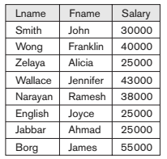
Unary Relational Operations: Examples
Π _{Lname, Fname, Salary}(EMPLOYEE)
Output ??

Slide 17
Unary Relational Algebra Expressions:
We may want to apply several relational algebra operations one after the other.
Either we can write the operations as a single relational algebra expression by nesting the operations, or
We can apply one operation at a time and create intermediate result relations.
In the latter case, we must give names to the relations that hold the intermediate results.

Slide 18
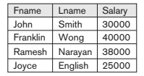
Single expression versus sequence of relational operations (Example):
Example : To retrieve the first name, last name, and salary of all employees who work in department number 5,
We must apply a select and a project operation
We can write a single relational algebra expression also known as an in-line expression, as follows:
Π _{FNAME, LNAME, SALARY}(σ _{DNO=5}(EMPLOYEE))

Slide 19
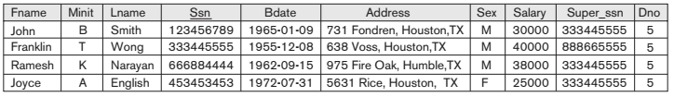

Single expression versus sequence of relational operations (Example):
OR We can explicitly show the sequence of operations, giving a name to each intermediate relation:
DEP5_EMPS ← σ _{DNO=5}(EMPLOYEE)
RESULT ← Π _{FNAME, LNAME, SALARY} (DEP5_EMPS)
TEMP
R

Slide 20
Unary Relational Operations: RENAME
The RENAME operator is denoted by ρ (rho)
In some cases, we may want to rename the attributes of a relation or the relation name or both
Useful when a query requires multiple operations
Necessary in some cases (see JOIN operation later)
The general RENAME operation ρ can be expressed by any of the following forms:
ρ_{S (B1, B2, …, Bn )}(R) changes both:
the relation name to S, and
the column (attribute) names to B1, B2, …..Bn
ρ_{S}(R) changes:
the relation name only to S
ρ_{(B1, B2, …, Bn )}(R) changes:
the column (attribute) names only to B1, B2, …..Bn

Slide 21
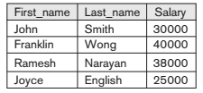
Unary Relational Operations: RENAME
Example :
ρ _{DEP5_EMPS} (σ _{DNO=5}(EMPLOYEE))
DEP5_EMPS
ρ RESULT (First_name, Last_name, Salary) (Π _{FNAME, LNAME, SALARY} (DEP5_EMPS))
RESULT

Slide 22
Relational Algebra Operations from Set Theory :
Type Compatibility of operands is required for the binary set operation UNION ∪ , (also for INTERSECTION ∩, and SET DIFFERENCE –, see next slides)
R1(A1, A2, ..., An) and R2(B1, B2, ..., Bn) are type compatible if:
they have the same number of attributes, and
the domains of corresponding attributes are type compatible
(i.e. dom(Ai)=dom(Bi) for i=1, 2, ..., n).
The resulting relation for R1 ∪ R2 (also for R1 ∩ R2, or R1–R2, see next slides) has the same attribute names as the first operand relation R1 (by convention)

Slide 23
Relational Algebra Operations from Set Theory: UNION
UNION Operation
Binary operation, denoted by ∪
The result of R ∪ S, is a relation that includes all tuples that are either in R or in S or in both R and S
Duplicate tuples are eliminated
The two operand relations R and S must be “type compatible” (or UNION compatible)
R and S must have same number of attributes
Each pair of corresponding attributes must be type compatible (have same or compatible domains)

Slide 24
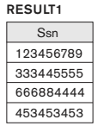
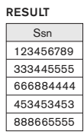
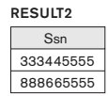
Relational Algebra Operations from Set Theory: UNION
Example:
To retrieve the social security numbers of all employees who either work in department 5 (RESULT1 below) or directly supervise an employee who works in department 5 (RESULT2 below)
We can use the UNION operation as follows:
DEP5_EMPS ← σ _{DNO=5} (EMPLOYEE)
RESULT1 ← Π _{SSN}(DEP5_EMPS)
RESULT2(SSN) ← Π _{SUPERSSN}(DEP5_EMPS)
RESULT ← RESULT1 ∪ RESULT2
The union operation produces the tuples that are in either RESULT1 or RESULT2 or both

Slide 25
Relational Algebra Operations from Set Theory : INTERSECTION
INTERSECTION is denoted by ∩
The result of the operation R ∩ S, is a relation that includes all tuples that are in both R and S
The attribute names in the result will be the same as the attribute names in R
The two operand relations R and S must be “type compatible”

Slide 26
Relational Algebra Operations from Set Theory : SET DIFFERENCE
SET DIFFERENCE (also called MINUS or EXCEPT) is denoted by –
The result of R – S, is a relation that includes all tuples that are in R but not in S
The attribute names in the result will be the same as the attribute names in R
The two operand relations R and S must be “type compatible”

Slide 27
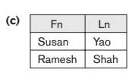
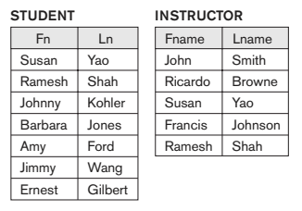
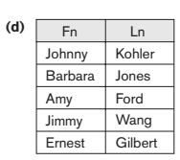
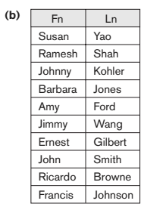
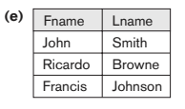
Relational Algebra Operations from Set Theory :
Example : The set operations UNION, INTERSECTION, and MINUS.
(a) Two union-compatible relations.
(b) STUDENT ∪ INSTRUCTOR.
(c) STUDENT ∩ INSTRUCTOR.
(d) STUDENT – INSTRUCTOR.
(e) INSTRUCTOR – STUDENT

Slide 28
Some properties of UNION, INTERSECT, and DIFFERENCE
Notice that both union and intersection are commutative operations; that is
R ∪ S = S ∪ R, and R ∩ S = S ∩ R
Both union and intersection can be treated as n-ary operations applicable to any number of relations as both are associative operations; that is
R ∪ (S ∪ T) = (R ∪ S) ∪ T
(R ∩ S) ∩ T = R ∩ (S ∩ T)
The minus operation is not commutative; that is, in general
R – S ≠ S – R

Slide 29
MCQ’S
Question : Suppose R1 (A, B) and R2 (C, D) are two relational schemas. Let r1 and r2 be two corresponding relation instances. B is foreign key that refers to C in R2. If data in r1 and r2 satisfy referential integrity constraints, which of the following is always TRUE? (GATE 2012)
Π_{C} (r2) - Π_{B} (r1) = ∅
Π_{B} (r1) = Π_{C} (r2)
Π_{B} (r1) - Π_{C} (r2) ≠ ∅
Π_{B} (r1) - Π_{C} (r2) = ∅
Answer : d) Π_{B} (r1) - Π_{C} (r2) = ∅
15

Slide 30
MCQ’S
Which of the following query transformations (i.e. replacing the LHS expression by the RHS expression) is incorrect? R₁ and R₂ are relations. C₁, C₂ are selection conditions and A₁, A₂ are attributes of R₁. (GATE 1998)
σ_{c1}(σ_{c2}(R1)) → σ_{c2}(σ_{c1}(R1))
σ_{c1}(Π_{A1}(R1)) → Π_{A1}(σ_{c1}(R1))
σ_{c1}(R1∪R2) → σ_{c1}(R1) ∪σ_{c1} (R2)
Π_{A1} (σ_{c1}(R1)) → σ_{c1} (Π_{A1}(R1))
Answer : (d) Π_{A1} (σ_{c1}(R1)) → σ_{c1} (Π_{A1}(R1))
15

Slide 31
References
Introduction to Relational algebra & Relational calculus, https://beginnersbook.com/2019/02/introduction-to-relational-algebra-calculus/
Elmasri, R. (2021). Fundamentals of database systems seventh edition.
Silberschatz, A., Korth, H. F., & Sudarshan, S. (1997). Database system concepts (Vol. 4). New York: McGraw-Hill.
Gill, P. S. (2010). Database management systems. IK International Pvt Ltd.

Slide 32
Thank You

